Slide 1

Threat Intelligence and Threat Hunting from a SOC Analyst Prospective

Slide 2
Threat Hunting VS Threat Intelligence
Threat Intelligence- Is the process of gathering data on emerging or existing actors or attacks using tools and techniques to generate patters on how to protect against potential risks
Threat Hunting- Uses these data to check if any bad actors has shown on the environment
SOC Analyst: Uses threat intelligence to perform threat hunting on their environment.

Slide 3
Threat Intelligence Classifications
Strategic Intel- Looks into an organization’s landscape and maps out the risk areas based on some trends and patterns seen
Technical Intel- Looks into any evidence of attacks by an adversary
Tactical Intel- Assesses TTPs which stands for Adversaries' tactics, techniques and procedures.
Operational Intel- Investigates an adversary’s specific motives and intent to perform an attack. (Think like a hacker class tries to explore some of these concepts for those who are interested)
This intel can strengthen security controls and address vulnerabilities through real-time investigations.

Slide 4
Frameworks Models Used in Threat Intelligence
Models in Threat Intelligence are important because they are built to determine the level of difficulty that an adversary would have to go through to reach our system and what level of preparation is needed
Some of these framework models include:
Pyramid of Pain
Cyber Kill Chain
Unified Kill Chain
Diamond Model
MITRE ATT&CK

Slide 5
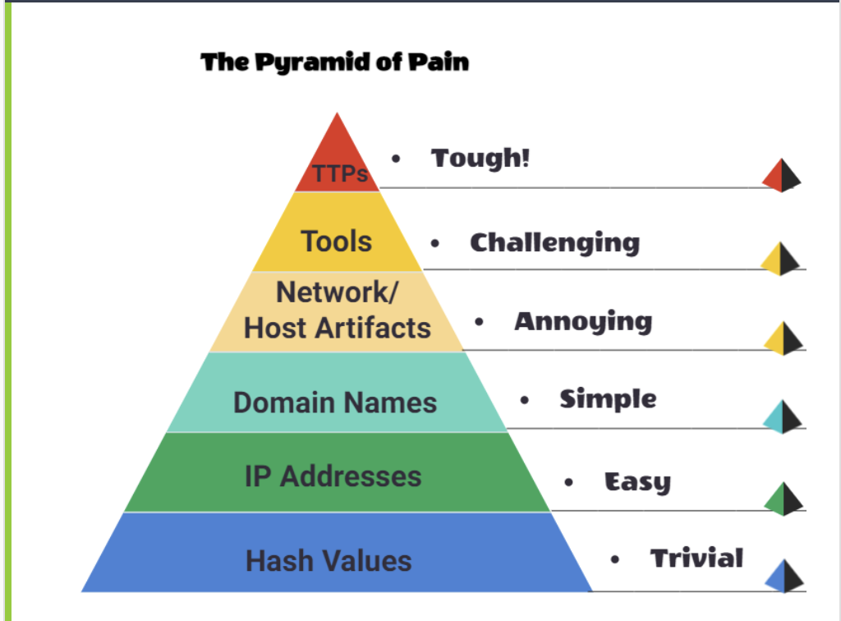
Pyramid of Pain

Slide 6
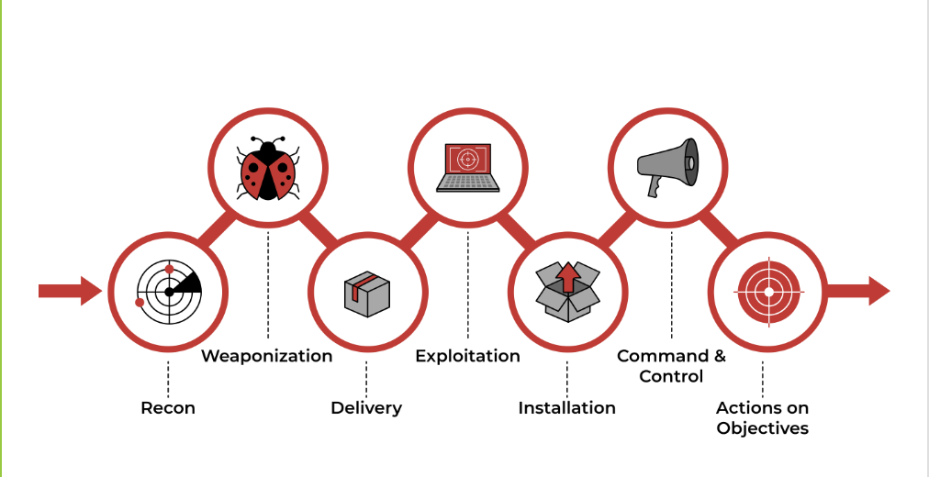
Cyber Kill Chain

Slide 7
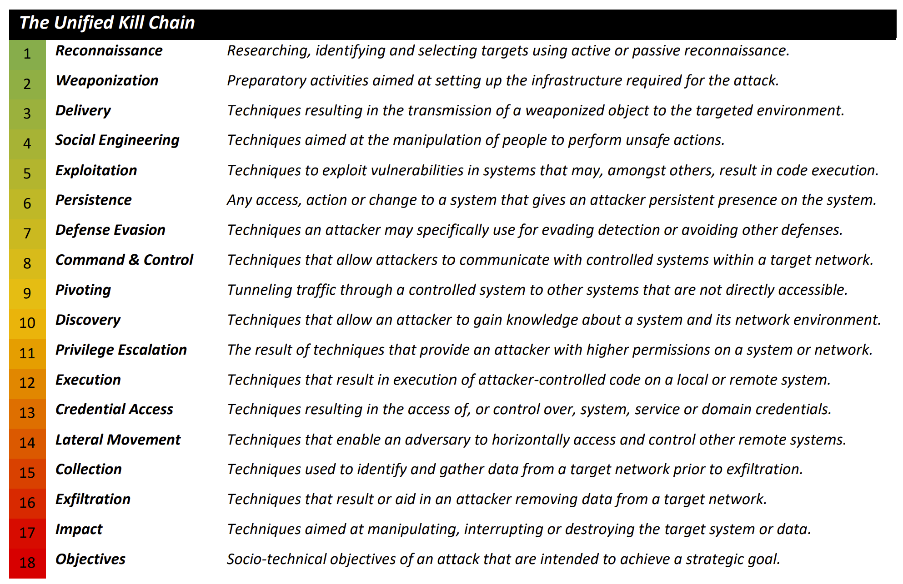

Slide 8
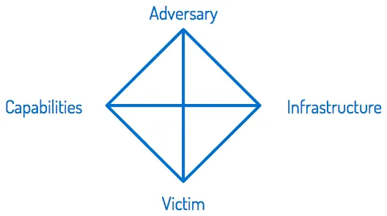
Diamond Model

Slide 9
MITRE
"At MITRE, we solve problems for a safer world. Through our federally funded R&D centers and public-private partnerships, we work across government to tackle challenges to the safety, stability, and well-being of our nation.”
MITRE is used by organizations to understand their security readiness and uncover vulnerabilities in their defenses.

Slide 10
MITRE Terminology
APT- Advanced Persistent Threat- can be considered a team/group (threat group), or even country (nation-state group), that engages in long-term attacks against organizations and/or countries.
TTP- Tactics, Technique, and Procedures- o The Tactic is the adversary's goal or objective. o The Technique is how the adversary achieves the goal or objective. o The Procedure is how the technique is executed.
CAR- Cyber Analytics Repository- is a knowledge base of analytics developed by MITRE based on the MITRE ATT&CK® adversary model.
MITRE Engage- is a framework for planning and discussing adversary engagement operations that empowers you to engage your adversaries and achieve your cybersecurity goals.
MITRE D3FEND- Detection, Denial, and Disruption Framework Empowering Network Defense. A knowledge graph of cybersecurity countermeasures.

Slide 11

MITRE ATT&CK Github link An easier way to search
https://mitre-attack.github.io/attack-navigator/#layerURL=https%3A%2F%2Fattack.mitre.org%2Fgroups%2FG0008%2FG0008-enterprise-layer.json
https://mitre-attack.github.io/attack-navigator/

Slide 12

MITRE TryHackMe Room
https://tryhackme.com/room/mitre

Slide 13
TOOLS USED IN THREAT HUNTING BY A SOC ANALYST BESIDES WHAT WE MENTIONED SO FAR
urlscan.io - A great tool when scanning and analyzing websites. It records activities and interactions of one website to other websites, kind of like where goes websites or Virus Total
Yara - is a language that you can use to write rules to detect malware and malicious files.
Abuse.ch is a research project from Bern University that has created some interesting tools when it comes to Threat Hunting such as:
Malware Bazaar: A resource for sharing malware samples- https://bazaar.abuse.ch/ You can search there if something has been reported as malware
Feodo Tracker: A resource used to track botnet command and control (C2) infrastructure linked with Emotet, Dridex and TrickBot. https://feodotracker.abuse.ch/browse/
SSL Blacklist: A resource for collecting and providing a blocklist for malicious SSL certificates and JA3/JA3s fingerprints. https://sslbl.abuse.ch/
URL Haus: A resource for sharing malware distribution sites. https://urlhaus.abuse.ch/
Threat Fox: A resource for sharing indicators of compromise (IOCs). https://threatfox.abuse.ch/

Slide 14
Threat Intel Resources and Guides to learn more about Threat Intelligence and Threat Hunting
Katie Nickels (SANS Instructor, Industry Leader)
https://medium.com/katies-five-cents/faqs-on-getting-started-in-cyber-threat-intelligence-f567f267348e
https://medium.com/katies-five-cents/a-cyber-threat-intelligence-self-study-plan-part-1-968b5a8daf9a
https://medium.com/katies-five-cents/a-cyber-threat-intelligence-self-study-plan-part-2-d04b7a529d36
https://www.threatintel.academy/
https://chrissanders.org/training/cuckoosegg/
https://unprotect.it/map/

